Slide 1
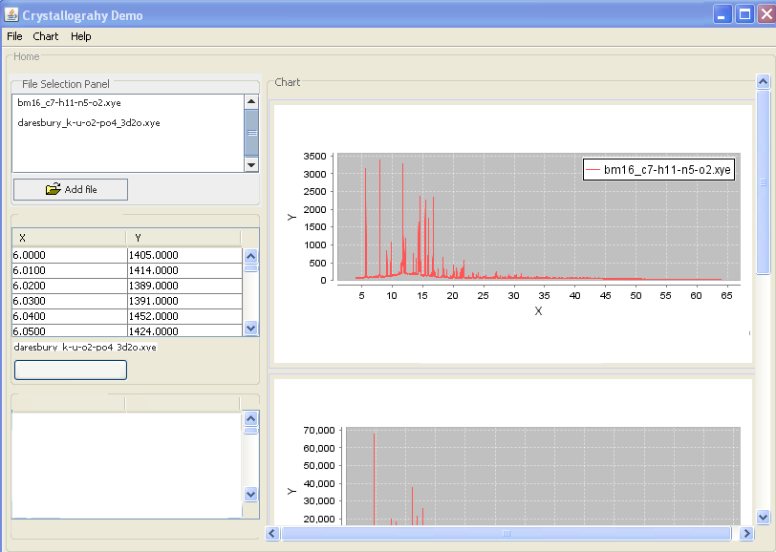
1
2
(s)
Dataset in focus
3
Save modified data
5
Dataset properties
4
Name
Value
Source x-ray
Wavelenght unknown
.
.
Etc.

